Slide 1
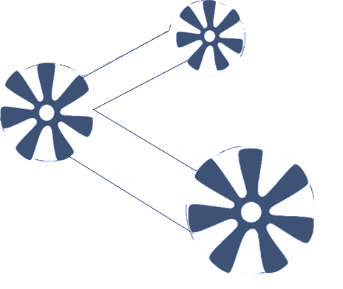






Slide 2


Vizyonumuz
Veri Bilimi alanında uluslararası bir bilgi alış verişi platformu oluşturmak.
Misyonumuz
Veri Bilimi alanında uzman; akademi ve iş dünyasından profesyonellerin katılacağı; workshoplar, konferanslar ve paneller düzenlemek.

Slide 3


Gelecek Planlarımız
Beklentilerimiz

Slide 4
Ajanda
Tanışma
Data Structures / Visualization
Data Preprocessing
Break
Most Common Softwares Used in Data Science – R & Python
Questions / Answers

Slide 5



Introduction - Who am I?
Bachelor Degree: Statistics – Eskişehir Osmangazi University
Master Degree: Industrial Engineering – TOBB Economy andTechnology University
Hugo Boss, Big Data Analyst – IT Department
Via - Vis Bilişim, Data Scientist – IT Department

Slide 6




Ömer Adıgüzel
Omer.adiguzel@tr.bosch.com
Bachelor: Mathematics (major) + Actuarial Sciences (minor)
MsE: Management Information Systems & Engineering
MsE: Industrial Engineering (left at thesis step)
MsC: Computer Science / IT - (ongoing)
Bosch Thermotechnic – Controlling & PJM/PD
Arcelik A.S., Innovation / R&D Department
Arcelik A.S., Risk Management Department
Liberty Mutual Insurance, Sales Development Department
Customer Segmentation by using Smart TV Channel Usages
Predictive Maintenance for POS Devices
Test Time Reduction on Fridge Frezeers
Monte Carlo Simulation for Global Claim Exposure
Sentiment Analysis on Call Center Data
Beyondcare Cardio Patch, Clinical Research & Study
Professional musician
Co-Founder of Data Science & Big Data Izmir Meetup
Notes:
As a background; … still studying / before joining bosch, some of the main projects / lastly Professional musician, founder 405 members

Slide 7


Alican Cömert
alican.comert@bosch.com
Bosch Thermotechnic, Data Scientist, Product Cost Controller
ASELSAN – Process and Quality Engineer
Hugo Boss – Management Trainee
Bachelor: Industrial Engineering– Economics (minor) METU (2006-2011)
MsC: Industrial Engineering METU (2012-2014)
Bosch Dashboard Concept for Financial KPIs
Smart Project Planning Tool
Diabetics Diagnose Project
A branch and bound algorithm for project scheduling problem with discounted cash flows (Int. J. Planning and Scheduling, 2016)
Türk Kizilayi Orta Anadolu Bölgesi Kan Ürünleri Tedarik Zinciri Yönetimi Projesi – Endüstri Mühendisliği Dergisi (Cilt 22, Sayı:3, 2012)
Notes:
As a background; … still studying / before joining bosch, some of the main projects / lastly Professional musician, founder 250 members

Slide 8
Introduction to Python

Slide 9

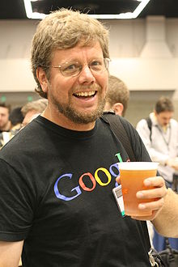
Monty Python's Flying Circus
Paradigm Object-oriented, imperative, functional, procedural, reflective
Designed by Guido van Rossum
Developer Python Software Foundation
First appeared 1990
Stable release
3.6.5 / 28 March 2018,
2.7.14 / 16 September 2017
Typing discipline Duck, dynamic, strong
License Python Software Foundation License
Filename extensions .py, .pyc, .pyd, .pyo (prior to 3.5), .pyw, .pyz (since 3.5)
Website python.org
Influenced by ABC, ALGOL 68, C, C++,CLU, Dylan,Haskell,Icon,Java,Lisp,Modula-3, Perl
Influenced Boo, Cobra, Coconut, CoffeeScript, D, F#, Falcon, Genie, Go, Groovy, JavaScript, Julia, Nim, Ring, Ruby,Swift

Slide 10
Introduction to Python
Python is an interpreted high-level programming language for general-purpose programming.
Philosophy:
import this

Slide 11
Introduction to Python
Easy Syntax
Readability
Open source general-purpose language.
Object Oriented, Procedural, Functional
Easy to interface with C/ObjC/Java/Fortran
Easy-ish to interface with C++ (via SWIG)
Great interactive environment
Downloads: http://www.python.org
Documentation: http://www.python.org/doc/
Widely Supported
High-Level Language
It's Safe
Cross-platform
Batteries Included
Extensible

Slide 12
Introduction to Python
Python is Interpreted − Python is processed at runtime by the interpreter. You do not need to compile your program before executing it. This is similar to PERL and PHP.
Python is Interactive − You can actually sit at a Python prompt and interact with the interpreter directly to write your programs.
Python is Object-Oriented − Python supports Object-Oriented style or technique of programming that encapsulates code within objects.
Python is a Beginner's Language − Python is a great language for the beginner-level programmers and supports the development of a wide range of applications from simple text processing to www browsers to games.

Slide 13
Versions
1- Python 2x
Introduced list comprehensions, a feature borrowed from the functional programming languages SETL and Haskell. Python's syntax for this construct is very similar to Haskell's, apart from Haskell's preference for punctuation characters and Python's preference for alphabetic keywords. Python 2.0 also introduced a garbage collection system capable of collecting reference cycles.
2- Python 3x
Python 3.0 (also called "Python 3000" or "Py3K") was released on December 3, 2008. It was designed to rectify fundamental design flaws in the language—the changes required could not be implemented while retaining full backwards compatibility with the 2.x series, which necessitated a new major version number. The guiding principle of Python 3 was: "reduce feature duplication by removing old ways of doing things".

Slide 14
Enough to Understand the Code
Assignment uses = and comparison uses ==
For numbers + - * / % are as expected
Special use of + for string concatenation
Special use of % for string formatting (as with printf in C)
Logical operators are words (and, or, not) not symbols
The basic printing command is print
The first assignment to a variable creates it
Variable types don’t need to be declared
Python figures out the variable types on its own

Slide 15
Data Structures
>>> dict = {'Name': ‘Big Data', 'Age': 10, 'Class': 'First'}
>>> dict['Age'] = 13; # update existing entry
>>> dict['School'] = "Ege University"
>>> dict['Name']
List It is a sequence of multiple values. It allows us to store different types of data such as integer, float, string etc.
li = [“abc”, 34, 4.34, 23]
Tuple A tuple is similar to a list in the sense that it is a sequence of elements
tu = (23, ‘abc’, 4.56, (2,3), ‘def’)
Dictionary
Another useful data type built into Python is the. Dictionaries are sometimes found in other languages as “associative memories” or “associative arrays”. Unlike sequences, which are indexed by a range of numbers, dictionaries are indexed by keys, which can be any immutable type; strings and numbers can always be keys.

Slide 16
Whitespace
Whitespace is meaningful in Python: especially indentation and placement of newlines.
Use a newline to end a line of code.
Use \ when must go to next line prematurely.
No braces { } to mark blocks of code in Python… Use consistent indentation instead.
The first line with less indentation is outside of the block.
The first line with more indentation starts a nested block
Often a colon appears at the start of a new block. (E.g. for function and class definitions.)
>>>weekdays = ["Monday", "Tuesday", "Wednesday", "Thursday", "Friday"] >>>for i, day in enumerate(weekdays):
>>> print("{} is weekday {}".format(day, i))

Slide 17
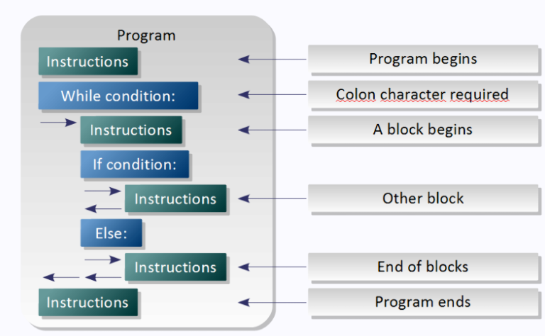
Blocks
In Python, code blocks are defined by the use of indentation, which should be constant in the code block, but it is considered good practice to maintain consistency throughout the project and avoid mixing tabs and
"The official recommendation coding style: (http://www.python.org/dev/peps/pep-0008/) is to use four spaces for indentation and this convention is widely accepted by developers..

Slide 18
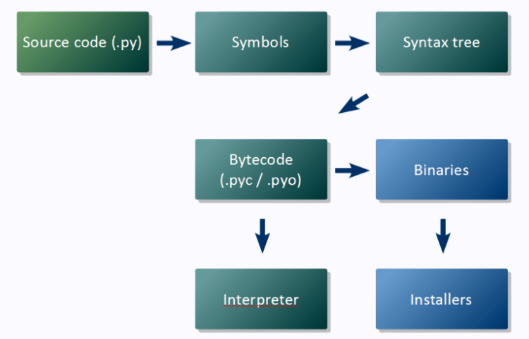
Compilation and Interpretation
The source code is translated by Python to bytecode, which is a binary format with instructions for the interpreter. The bytecode is cross platform and can be distributed and run without the original source.

Slide 19
Examples
YES
NO
foo = long_function_name(var_one, var_two,
var_three, var_four)
foo = long_function_name(var_one, var_two, var_three, var_four)
spam(ham[1], {eggs: 2})
spam( ham[ 1 ], { eggs: 2 } )
if x == 4: print x, y; x, y = y, x
if x == 4 : print x , y ; x , y = y , x
spam(1)
spam (1)
def complex(real, imag=0.0): return magic(r=real, i=imag)
def complex(real, imag = 0.0): return magic(r = real, i = imag)
if foo == 'blah': do_blah_thing()
if foo == 'blah': do_blah_thing() else: do_non_blah_thing()

Slide 20
Comments
Start comments with # – the rest of line is ignored.
Can include a “documentation string” as the first line of any new function or class that you define.
The development environment, debugger, and other tools use it: it’s good style to include one.
def my_function(x, y):
“““This is the docstring. This function does blah blah blah.”””
# The code would go here...

Slide 21
Assignment
Binding a variable in Python means setting a name to hold a reference to some object.
Assignment creates references, not copies
Names in Python do not have an intrinsic type. Objects have types.
Python determines the type of the reference automatically based on the data object assigned to it.
You create a name the first time it appears on the left side of an assignment expression: x = 3
A reference is deleted via garbage collection after any names bound to it have passed out of scope.
Multiple assignment (x, y = 2, 3)
Notes:
Multiple Assignment • You can also assign to multiple names at the same time. >>> x, y = 2, 3

Slide 22
Understanding Reference Semantics
Assignment manipulates references
—x = y does not make a copy of the object y references
—x = y makes x reference the object y references
Very useful; but beware!
Example:
>>> a = [1, 2, 3] # a now references the list [1, 2, 3]
>>> b = a # b now references what a references
>>> a.append(4) # this changes the list a references
>>> print b # if we print what b references,
[1, 2, 3, 4] # SURPRISE! It has changed…

Slide 23
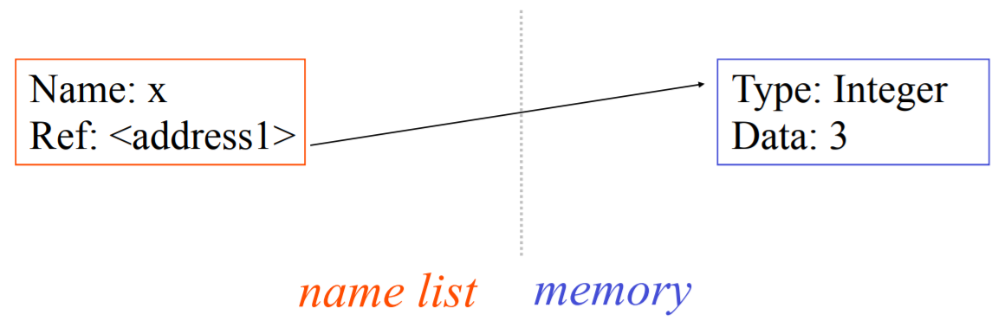
Understanding Reference Semantics II
There is a lot going on when we type: x = 3
First, an integer 3 is created and stored in memory
A name x is created
A reference to the memory location storing the 3 is then assigned to the name x
So: When we say that the value of x is 3
we mean that x now refers to the integer 3

Slide 24
Understanding Reference Semantics III
The data 3 we created is of type integer. In Python, the datatypes integer, float, and string (and tuple) are “immutable.”
This doesn’t mean we can’t change the value of x, i.e. change what x refers to …
For example, we could increment x:
>>> x = 3
>>> x = x + 1
>>> print x
4

Slide 25
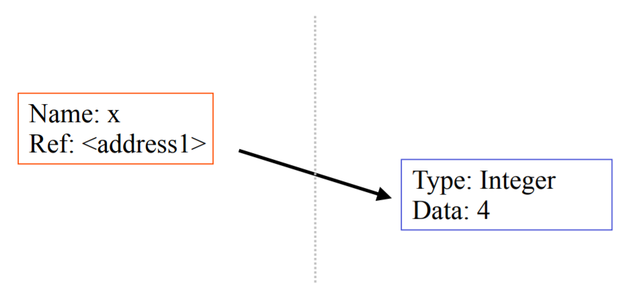
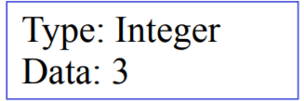
Understanding Reference Semantics IV
If we increment x, then what’s really happening is:
The reference of name x is looked up.
The value at that reference is retrieved.
The 3+1 calculation occurs, producing a new data element 4 which is assigned to a fresh memory location with a new reference.
The name x is changed to point to this new reference.
The old data 3 is garbage collected if no name still refers to it.

Slide 26
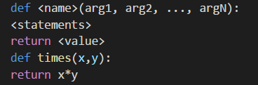
Functions
def creates a function and assigns it a name
return sends a result back to the caller
Arguments are passed by assignment
Arguments and return types are not declared

Slide 27
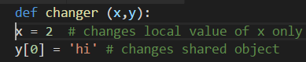
Passing Arguments to Functions
Passed arguments are assigned to local names
Assignment to argument names don't affect the caller
Changing a mutable argument may affect the caller

Slide 28
Eurekas for Functions
All functions in Python have a return value
even if no return line inside the code.
Functions without a return, return the special value None.
There is no function overloading in Python.
Two different functions can’t have the same name, even if they have different arguments.
Functions can be used as any other data type. They can be:
Arguments to function
Return values of functions
Assigned to variables
Parts of tuples, lists, etc

Slide 29
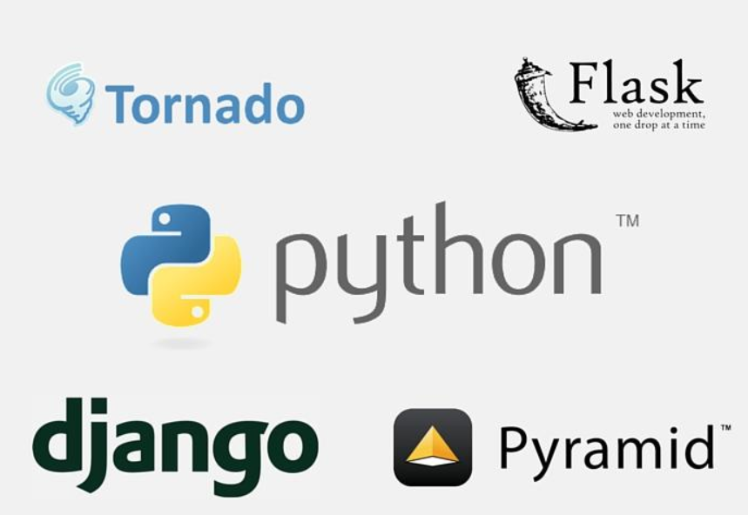
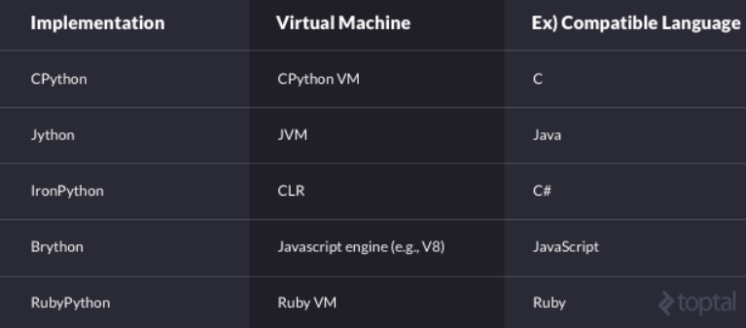
Libraries
Graphical user interfaces
Web frameworks
Multimedia
Databases
Networking
Test frameworks
Automation
Web scraping
Documentation
System administration
Scientific computing
Text processing
Image processing

Slide 30
numpy
matplotlib
SciPy
Offers Matlab-ish capabilities within Python
Fast array operations
2D arrays, multi-D arrays, linear algebra etc.
High quality plotting library
SciPy is a library of software for engineering and science.
SciPy contains modules for linear algebra, optimization, integration, and statistics.
Seaborn
Pandas
Keras
NLTK
Pandas is a Python package designed to do work with “labeled” and “relational” data simple and intuitive. Pandas is a perfect tool for data wrangling. It designed for quick and easy data manipulation, aggregation, and visualization.
Seaborn is mostly focused on the visualization of statistical models; such visualizations include heat maps, those that summarize the data but still depict the overall distributions.
Machine learning library
NLP - Machine learning library
Bokeh
TensorFlow
SciKit-Learn
Another great visualization library is Bokeh, which is aimed at interactive visualizations
Machine learning library
Plotly
Theano
Machine learning library
Finally, a word about Plotly. It is rather a web-based toolbox for building visualizations, exposing APIs to some programming languages (Python among them)
Machine learning library

Slide 31

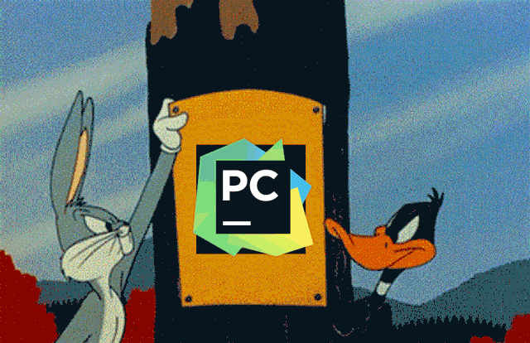






ATOM
VS CODE

Slide 32
Introduction to R

Slide 33


Paradigm Multi-paradigm: Array, object-oriented, imperative, functional, procedural, reflective
Designed by Ross Ihaka and Robert Gentleman
Developer R Core Team
First appeared 1993
Stable release 3.4.4 / 28 March 2018
Typing discipline Dynamic
License GNU, GPL
Filename extensions .r, .R, .RData, .rds, .rda
Website www.r-project.org
Influenced by Common Lisp, S, Scheme, XLispStat
Influenced Julia

Slide 34
Introduction to R
“To understand computations in R, two slogans are helpful:
Everything that exists is an object.
Everything that happens is a function call."
— John Chambers
R is a programming language and free software environment for statistical computing and graphics that is supported by the R Foundation for Statistical Computing.
R is an implementation of the S programming language combined with lexical scoping semantics inspired by Scheme. S was created by John Chambers in 1976, while at Bell Labs. There are some important differences, but much of the code written for S runs unaltered.
You can run your code without any Compiler - R is an interpreted language. Hence we can run Code without any compiler. R interprets the Code and makes the development of code easier.
Many calculations done with vectors - R is a vector language, so anyone can add functions to a single Vector without putting in a loop. Hence, R is powerful and faster than other languages.
Statistical Language- R used in biology, genetics as well as in statistics. R is a turning complete language where any type of task can perform

Slide 35
Introduction to R
R is a powerful data-analysis package with many standard and cutting-edge statistical functions. See the Comprehensive R Archive Network (CRAN)'s Task Views to get an idea of what you can do with R.
R is widely used in political science, statistics, econometrics, actuarial sciences, sociology, finance, etc.
R is available for all major operating systems (Windows, Mac OS, GNU-Linux).
R syntax is much more systematic than Stata or SAS syntax.
R can be installed on your USB stick !

Slide 36
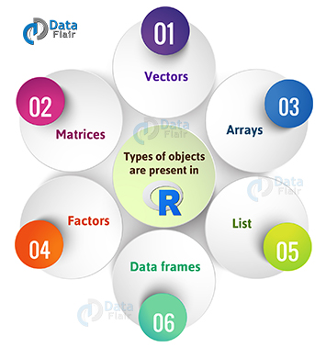
Data Types
vector: an ordered collection of data of the same type
a = c(1,2,3)
matrix: a rectangular table of data of the same type
a <- matrix(c(1,2,3,4,5,6), 2,3)
array: 3-,4-,..dimensional matrix
vector: an ordered collection of data of the same type.
a = c(7,5,1)
list: an ordered collection of data of arbitrary types.
doe = list(name="john", age=28,married=F)
data frame: is supposed to represent the typical data table that researchers come up with – like a spreadsheet.

Slide 37
Frequently Used Operators
<- | Assign
+ | Sum
- | Difference
* | Multiplication
/ | Division
^ | Exponent
%% | Mod
%*% | Dot product
%/% | Integer division
%in% | Subset
| | Or
& | And
< | Less
> | Greater
<= | Less or =
>= | Greater or =
! | Not
!= | Not equal
== | Is equal

Slide 38
Statistical features
R and its libraries implement a wide variety of statistical and graphical techniques:
Linear & nonlinear modeling,
Classical statistical tests,
Time-series analysis,
Classification, clustering
Neural Network, XGB, LGB, LSTM, etc…
R is easily extensible through functions and extensions
R community is noted for its active contributions in terms of packages.
Many of R's standard functions are written in R itself, which makes it easy for users to follow the algorithmic choices made.
For computationally intensive tasks, C, C++, and Fortran code can be linked and called at run time.
Static graphs
Dynamic graphs (including geospatial)

Slide 39
Functions
functionname <- function(arg1, arg2, ... ){ # declare name of function and function arguments
statements # declare statements
return(object) # declare object data type
}
Ex:
sumofsquares <- function(x) { # a user-created function
return(sum(x^2)) # return the sum of squares of the elements of vector x
}

Slide 40
Packages
12506 available packages (by now)
R is a programming language, so its abilities can easily be extended through the use of user-defined functions. A large collection of user-contributed functions and packages can be found in CRAN's Contributed Packages.
You can create your own library !
We have also some Turkish package writers!

Slide 41
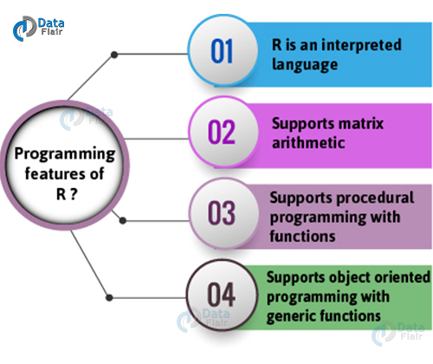
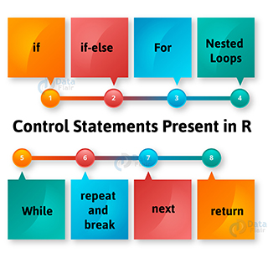
Programming
Runs on memory !
Try Linear Programming!

Slide 42
Apply Family
lapply
To each element of the list li, the function function is applied.
The result is a list whose elements are the individual function results.
sapply
Like apply, but tries to simplify the result, by converting it into a vector or array of appropriate size
apply
Apply the function fct along some dimensions of the array arr, according to margin, and return a vector or array of the appropriate size.
mapply
The mapply() function stands for ‘multivariate’ apply. Its purpose is to be able to vectorize arguments to a function that is not usually accepting vectors as arguments.
tapply, vapply..

Slide 43
Pipe Operator
f(x) can be rewritten as x %>% f
# Compute the logarithm of `x`
log(x) - x %>% log()
iris %>% subset(Sepal.Length > mean(Sepal.Length)) %$% cor(Sepal.Length, Sepal.Width)
data.frame(z = rnorm(100)) %$% ts.plot(z)

Slide 44
Packages
RMySQL, RPostgresSQL, RSQLite, Rhadoop, SparkR, RODBC,mongolite, rmongodb, openxlsx…
htmltools, dplyr, tidyr, lubridate…
caret, H2o, tensorflow, keras, glm, randomforest, tm, survival, svm, e1071…
ggplot2, plotly, highcharts, rhandsontable, amCharts, rCharts, leaflet, ggmap, googleVis, htmlwidgets, diagrammeR, threeJS, network3D, dygraphs, zoo, xts, quantmod…
Rmarkdown, Shiny, XML, jsonlite, httr, xtable…

Slide 45


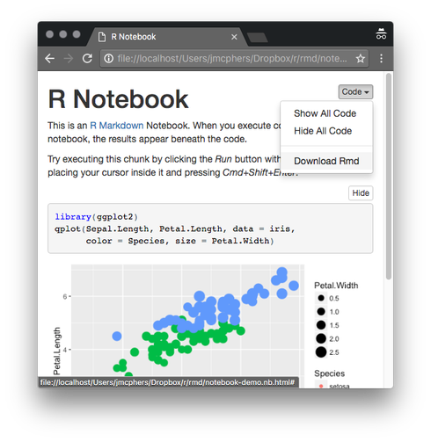
IDE
VS CODE

Slide 46
Altın Sponsor
Gümüş Sponsor

Slide 47


